Slide 1
Chapter 3
VLSI Subsystem Design
Jin-Fu Li
Advanced Reliable Systems (ARES) Laboratory Department of Electrical Engineering
National Central University Jhongli, Taiwan

Slide 2
Outline
 Introduction
 Datapath Operators
 Control Structures

Slide 3
System-Level Hierarchy
System (Top)
Complex units (cores) Simple Components
Logic Circuits
Silicon

Slide 4
Categories of Components
 Types of digital component
Datapath operators
Memory elements
Control structures
I/O cells
 Tradeoff of selection
Speed
Density
Programmability
Easy of design
etc

Slide 5
Datapath – Adder
Adder Truth Table
C A B A.B(G) A+B(P)
A B SUM CARRY
0 | 0 | 0 | 0 | 0 | 0 | 0 | 0
0 | 0 | 1 | 0 | 1 | 1 | 1 | 0
0 | 1 | 0 | 0 | 1 | 1 | 1 | 0
0 | 1 | 1 | 1 | 1 | 0 | 0 | 1
1 | 0 | 0 | 0 | 0 | 0 | 1 | 0
1 | 0 | 1 | 0 | 1 | 1 | 0 | 1
1 | 1 | 0 | 0 | 1 | 1 | 0 | 1
1 | 1 | 1 | 1 | 1 | 1 | 1 | 1
A B
Generate Signal G(A.B): occurs when a carry output (CARRY)
G P
CARRY
C
is internally generated within the adder .
Propagate Signal P(A+B): when it is true, the carry in signal C is passed
to the carry output (CARRY) when C is true
SUM

Slide 6
Datapath – Adder
SUM=A B C CARRY=AB+AC+BC
Single-bit schematic of SUM
A B C
-C
A
C
-A
-B
B
-A C
-A
A
B
SUM
A
-B
-A
SUM
A
-C

Slide 7
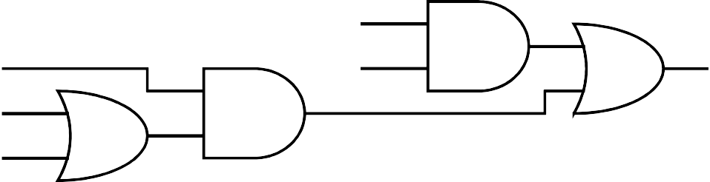
Datapath – Adder
Single-bit schematic of CARRY
A B
C A B
CARRY
CARRY
-C
-A
-B

Slide 8
Datapath – Adder
Optimized combinational adder schematic
C_{i+1}=A_{i}B_{i}+A_{i}C_{i}+B_{i}C_{i} S_{i}=(A_{i}+B_{i}+C_{i}).C_{i+1}+A_{i}B_{i}C_{i}
Vdd
A_{i} B_{i} C_{i}
^{C}i+1
^{C}i+1
S_{i}
S
i
C_{i} B_{i} A_{i}
Vss

Slide 9
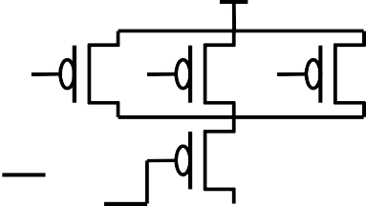
Datapath – Adder
Symmetrical optimized combinational adder schematic
A B
A
B
A B
A B C_{i}
^{C}out ^{C}out
C_{i}
S
B A
C_{i}
A
B
A
B
C_{i}
B A

Slide 10
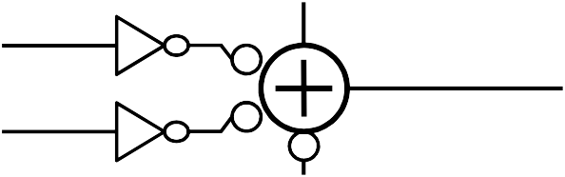
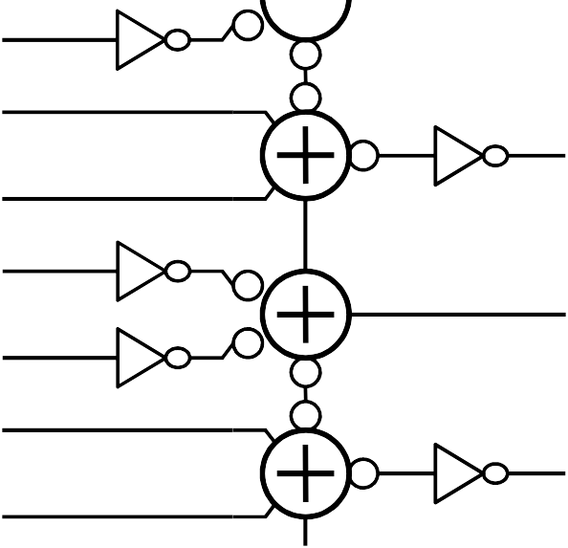
Datapath – Bit-Parallel Adder
Parallel adder implementations C<n+1>
C<n+1>
B<n> A<n>
B<n> A<n>
S<n>
S<n>
C<n>
C<n>
C<3>
C<3>
B<3>
B<3>
S<3>
S<3>
A<3> B<2>
A<2> B<1>
A<1> B<0>
A<0>
A<3> B<2>
A<2> B<1>
A<1> B<0>
A<0>
S<2>
S<2>
S<1>
S<1>
S<0>
S<0>
Cin
Cin

Slide 11
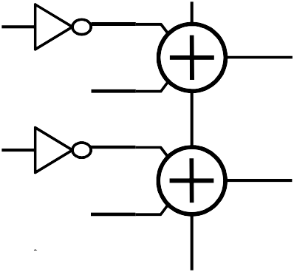
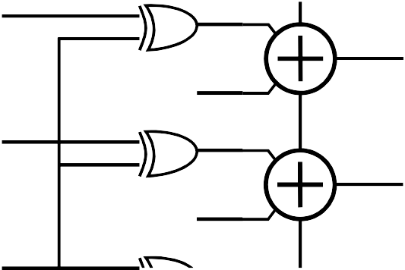
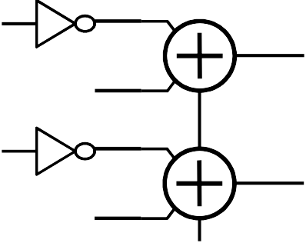
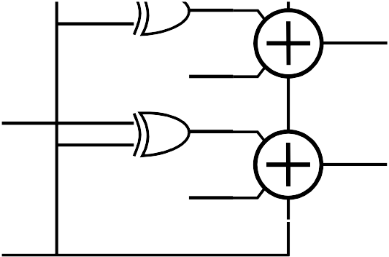
Datapath – Bit-Parallel Adder
C<3>
C<3>
B<3>
A<3> B<2>
A<2> B<1>
B<3>
S<3>
S<3>
A<3>
B<2>
S<2>
S<2>
A<2>
B<1>
S<1>
S<1>
A<1> B<0>
A<0>
A<1>
B<0>
S<0>
S<0>
A<0>
Vdd
Subtract
If (Subtract==0)
{S=A+B;}
else
A-B
{S=A-B;}

Slide 12
Datapath – Bit-Serial Adder
Cout
0110
A
0 1 1 0 1
addend
110
1001011011001 0
Result
0 1 0 0 1
B
0110
augend
001
Cin

Slide 13
Datapath – Carry Look-Ahead Adder (CLA)
 Objective
 To avoid the linear growth of the carry delay, we use a Carry Look-Ahead Adder (CLA) in which the carries can be generated in parallel
 Feature
 The Carry of each bit is generated from the propagate and the generate signals as well as the input carry
 The propagate and the generate signals are derived from the operand A_{i} and B_{i} by
 G_{i}=A_{i}.B_{i}
 P_{i}=A_{i}+B_{i}

Slide 14
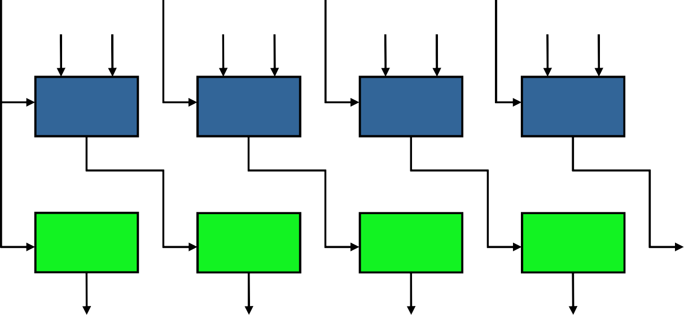
Datapath – Carry Look-Ahead Adder
C_{i+1}=A_{i}B_{i}+(A_{i}+B_{i})C_{i}=G_{i}+P_{i}C_{i} C₁=G₀+P₀C₀
C₂=G₁+P₁G₀+P₁P₀C₀ C₃=G₂+P₂G₁+P₂P₁G₀+P₂P₁P₀C₀ C₄=G₃+P₃G₂+P₃P₂G₁+P₃P₂P₁G₀+P₃P₂P₁P₀C₀
C₀
P₀ G₀
P₀-P₁ G₀-G₁
P₀-P₂ G₀-G₂
P₀-P₃
G₀-G₃
4-bit CLA
CLG1
CLG2
CLG3
CLG4
C₁
C₂
C₃
C₄
SG1
SG2
SG3
SG4
S₀
S₁
S₂
S₃

Slide 15
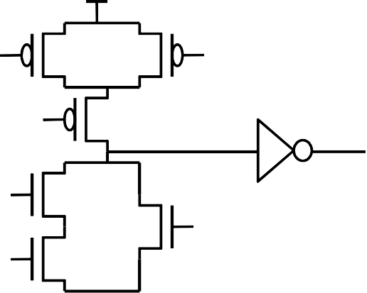
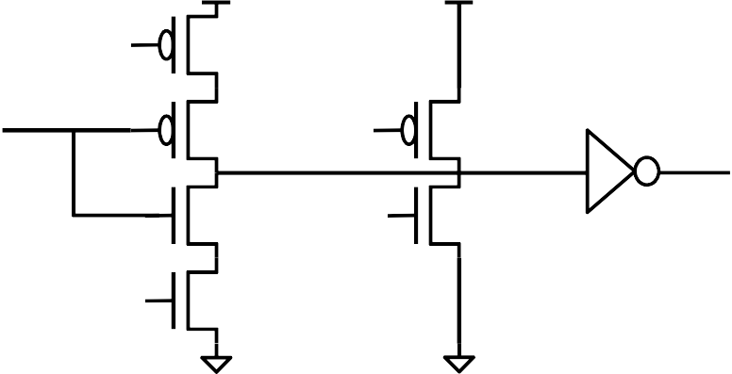
Datapath – Carry Look-Ahead Adder
CLG1
C₀
P₀
G₀
C₀ P₀
C₁
G₀
G₀
C₀
P₀ G₀
C₁
P₀

Slide 16

Datapath – Carry Look-Ahead Adder
CLG4
G₃ G₂ G₁ G₀
C₀
C₄
P₀ P₁ P₂ P₃
C₄=G₃+P₃G₂+P₃P₂G₁+P₃P₂P₁G₀+P₃P₂P₁P₀C₀

Slide 17
Datapath – Carry Look-Ahead Adder
Manchester Carry Chain
C_{i+1}=G_{i}+P_{i}C_{i} G_{i}=A_{i}.B_{i}
P_{i}=A_{i}+B_{i}
Introduce the carry-kill bit K_{i,} this term gets its name from the fact that if K_{i}=1, then P_{i} =0 and G_{i}=0, so that C_{i+1}=0; K_{i}=1 thus “kills” the carry-out bit.
K_{i}=A_{i}.B_{i}
 | A_{i} | B_{i} | P_{i} | G_{i} | K_{i}
 | 0 | 0 | 0 | 0 | 1
 | 0 | 1 | 1 | 0 | 0
 | 1 | 0 | 1 | 0 | 0
 | 1 | 1 | 0 | 1 | 0
G_{i}
P_{i}
^{C}i+1
C_{i}
K_{i}

Slide 18
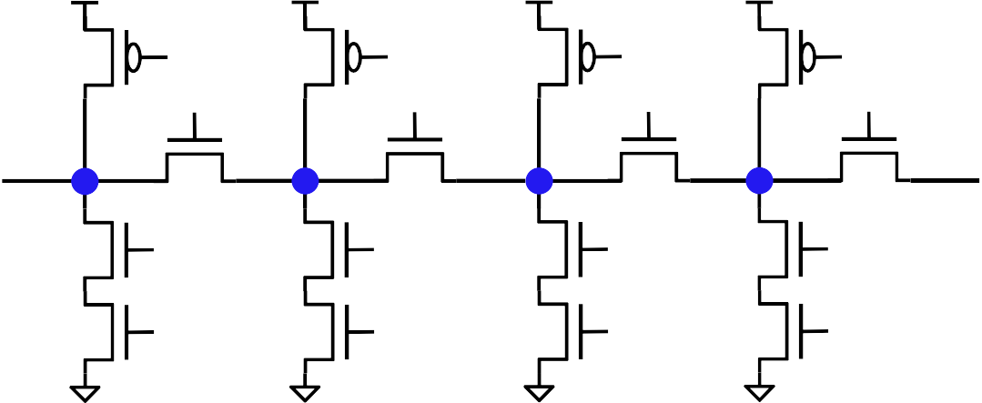
Datapath – Carry Look-Ahead Adder
Manchester circuit styles
G_{i}
P_{i}
P_{i}
^{C}i+1
C_{i}
C
C
G_{i} P_{i}
Static circuit
i+1
i
G
i
Clk
Dynamic circuit
Clk
P₃
P₂
P₁
P₀
C
4
C₀
G₃
G₂
G₁
G₀
Clk
C₄
C₃
C₂
C₁
Dynamic Manchester chain

Slide 19
Datapath – Carry Look-Ahead Adder
Extension to wide adders
If we use a brute-force approach for an 8-bit design, then the carry-out bit C₈ would have a term of the form
P₇ P₆ P₅ P₄ P₃ P₂ P₁ P₀ C ₀
Multilevel CLA networks can improve this problem
bit[n-1] bit[0]
n-bit adder
[i+3] [i]
4-bit CLG

Slide 20
Datapath – Carry Look-Ahead Adder
^{P}i+3
^{G}i+3
^{P}i+2
^{G}i+2
^{P}i+1
^{G}i+1
P_{i} G_{i}
block propagate
^{P}[i,i+3]
^{G}[i,i+3]
block generate
4-bit Carry Lookahead Generator
^{C}i+3
^{C}i+2
^{C}i+1
^{G}[i,i+3]^{=G}i+3^{+P}i+3^{G}i+2^{+P}i+3^{P}i+2^{G}i+1^{+P}i+3^{P}i+2^{P}i+1^{G}i ^{P}[i,i+3]^{=P}i+3^{P}i+2^{P}i+1^{P}i

Slide 21
Datapath – Carry-Skip Adder
A carry-skip adder is designed to speed up a wide adder by aiding the propagation of a carry bit around a portion of the entire adder.
[i+3]
[i]
^{c}i+4
c_{i}
^{c}i+k
c_{i}
4-bit adder
k-bit adder
^{P}[i,i+3]
Carry-skip
^{c}i+4^{+c}i^{.P}[i,i+3]
Carry-skip logic
Generalization
^{P}[i,i+3]^{=P}i+3^{P}i+2^{P}i+1^{P}i
^{Carry=C}i+4^{+P}[i,i+3]^{C}i

Slide 22
Datapath – Carry-Select Adder
b₇ a₇
b₆ a₆ b₅ a₅
4-bit adder U1 s₆ s₅
b₄ a₄
b₇ a₇
b₆ a₆ b₅ a₅
4-bit adder U0 s₆ s₅
b₄ a₄
c₈
c=1
c₈
c=0
s₇
s₄
s₇
s₄
b₃ a₃
b₂ a₂ b₁ a₁
4-bit adder L
b₀ a₀
1 0 1 0 1 0 1 0 1 0
MUX MUX MUX MUX MUX
c₄
c₀
c₈
s₇
s₆
s₅
s₄

Slide 23
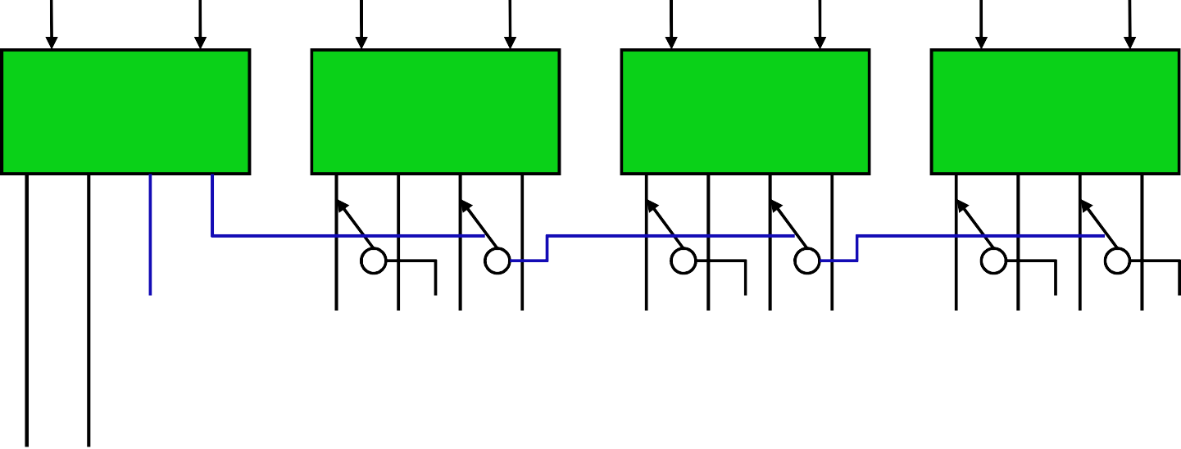
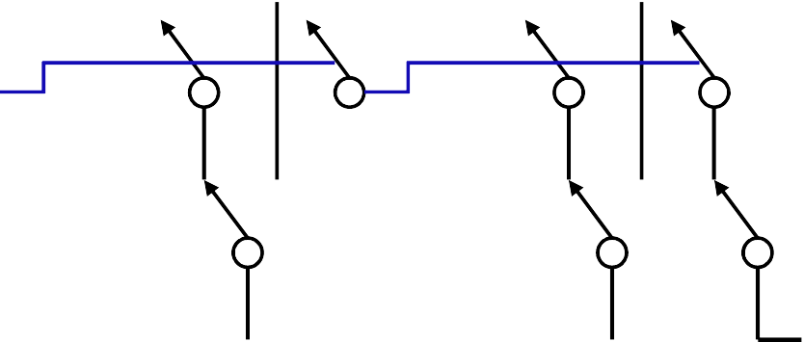
Datapath – Conditional-Sum Adder
A₀ B₀
Conditional cell
_{S}0 _{S}1 _{C}0 _{C}1
A₁ B₁
Conditional cell
_{S}0 _{S}1 _{C}0 _{C}1
A₂ B₂
Conditional cell
_{S}0 _{S}1 _{C}0 _{C}1
A₃ B₃
Conditional cell
_{S}0 _{S}1 _{C}0 _{C}1
C₀=C_{in}
S
S
S
S
C₄
0
1
2
3

Slide 24
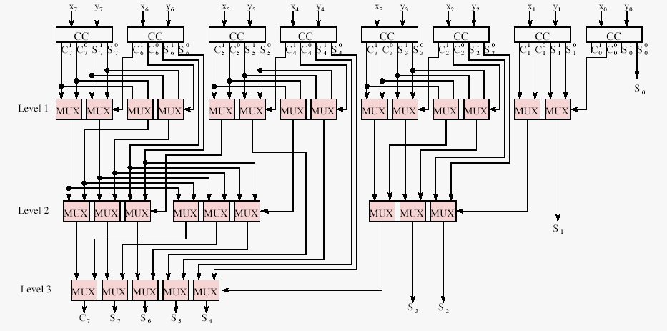
Datapath – 8-bit Conditional-Sum Adder

Slide 25
Datapath – Multipliers
Bit-level multiplier
a b
0 0
0 1
1 0
1 1
axb
0
0
0
1
a b
axb
Multiplication of two 4-bit words
a₃ b₃
a₂ b₂
a₁ b₁
a₀ b₀
a₃b₀ a₂b₁ a₁b₂ a₀b₃
a₂b₀ a₁b₁ a₀b₂
a₁b₀ a₀b₁
a₀b₀
a₃b₁ a₂b₂ a₁b₃
a₃b₂ a₂b₃
a₃b₃
p₇
p₆
p₅
p₄
p₃
p₂
p₁
p₀

Slide 26
Datapath – Multipliers
The product axb is given by the 8-bit result p=p₇p₆p₅p₄p₃p₂p₁p₀
The ith product term p_{i} can be expressed as
p_{i}
⁼ ∑ªj^{b}k ^{+ c}i−1
i= j +k
Alternate view of multiplication process
 |  | a₃ | a₂ | a₁ | a₀
 |  | b₃ | b₂ | b₁ | b₀
 |  | (a₃ | a₂ | a₁ | a₀) xb₀
(a₃ | (a₃ a₂ | a₂ a₁ | a₁ a₀)xb₂ | a₀)xb₁
(axb₀)2
0
(axb₁)2¹ (axb₂)2² (axb₃)2³
(a₃
a₂
a₁
a₀)xb₃
p₇
p₆
p₅
p₄
p₃
p₂
p₁
p₀

Slide 27
Datapath – Multipliers
Using a product register for multiplication
7
6
5
4
3
2
1
0
Product register
(axb₀)2⁰
(axb₁)2¹
(axb₂)2² (axb₃)2³

Slide 28
Datapath – Multipliers
Shift-right multiplication sequence
add (axb₀) shift right
a₃b₀
a₂b₀ a₃b₀
a₁b₀ a₂b₀
a₀b₀ a₁b₀
a₀b₀
a₃b₀ a₂b₁
a₂b₀ a₁b₁
a₃b₀ a₂b₁
a₁b₀ a₀b₁
a₂b₀ a₁b₁
a₀b₀
add (axb₁) shift right
c_{x}
a₃b₁
c_{x}
a₁b₀ a₀b₁
a₀b₀
a₃b₁
a₃b₀ a₂b₁ a₁b₂
a₂b₀ a₁b₁ a₀b₂
a₃b₀ a₂b₁ a₁b₂
a₁b₀ a₀b₁
a₀b₀
a₃b₁ a₂b₂
add (axb₂) shift right
c_{y} a₃b₂
a₂b₀ a₁b₁ a₀b₂
a₁b₀ a₀b₁
a₀b₀
c_{y}
a₃b₁ a₂b₂
a₃b₂
add (axb₃) shift right
a₃b₀ a₂b₁ a₁b₂ a₀b₃
a₂b₀ a₁b₁ a₀b₂
a₁b₀ a₀b₁
a₀b₀
a₃b₁ a₂b₂ a₁b₃
a₃b₂ a₂b₃
p₇ a₃b₃

Slide 29
Datapath – Register-Based Multiplier
Product register (2n)
clk shr
n
Multiplicand
Multiplier
0
n
n
MUX
n
n-bit adder
n

Slide 30
Datapath – Array Multipliers
Consider two unsigned binary integers X and Y
n−1 n−1
X =
∑ i
i
Y =
∑ j
Y 2 ^{j}
X 2
i=0
j=0
n−1
∑
n−1
P = X ×Y =
X 2 ⋅
i ∑ j
i
Y 2
j
i=0
n −1 n −1
⁼ ∑ ∑
i = 0 j = 0
n + n −1
j =0
( X Y ) 2
i + j
i j
=
∑
k = 0
P 2
k
k

Slide 31
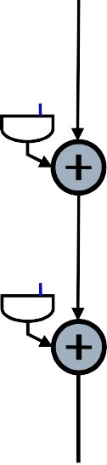

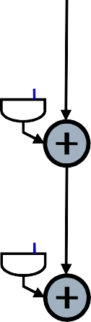
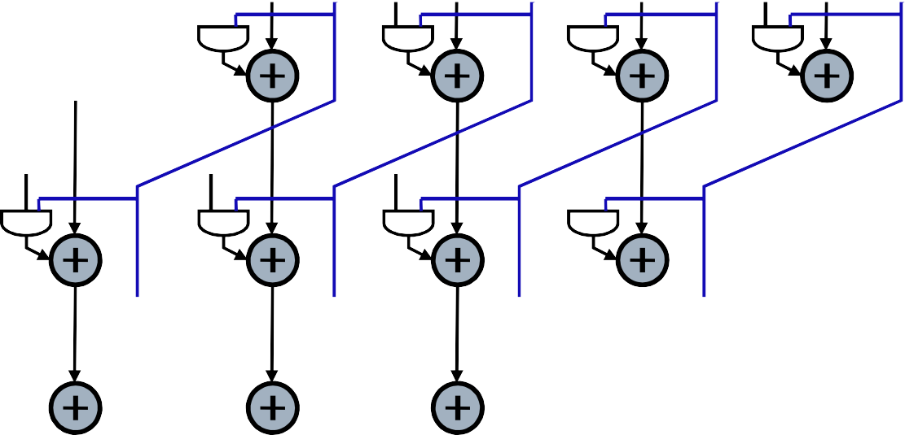
Datapath – Array Multipliers
X₃
X₂
X₁
X₀
Y₀
Y₁
P₀
Y₂
P₁
Y₃
P₂
P₃
P₇
P₆
P₅
P₄

Slide 32
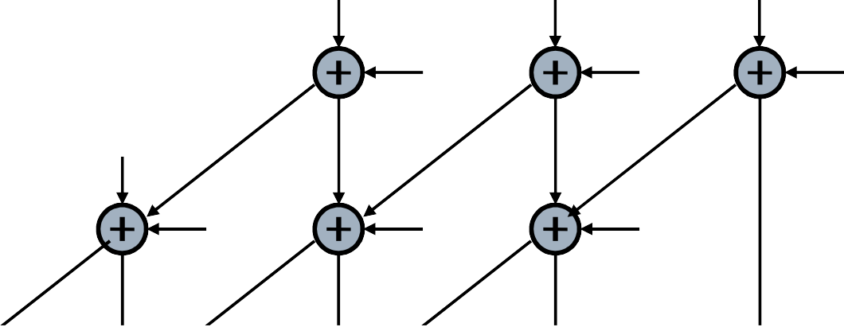
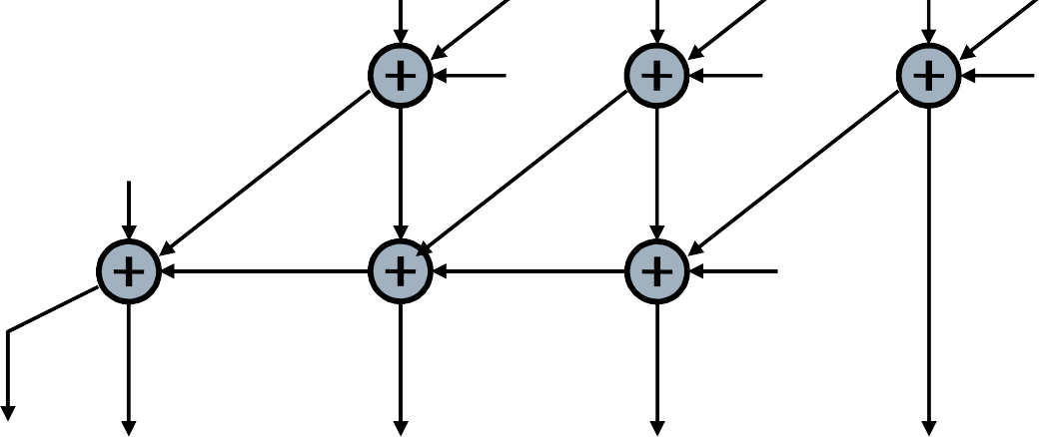
Datapath – Array Multipliers
X₃Y₀
0
X₂Y₀
0
X₁Y₀
0
X₀Y₀
X₂Y₁
X₁Y₁
X₀Y₁
X₃Y₁
X₂Y₂
X₁Y₂
X₀Y₂
X₃Y₂
X₂Y₃
X₁Y₃
X₀Y₃
X₃Y₃
0
P₇ P₆
P₅
P₄
P₃
P₂
P₁
P₀

Slide 33
Datapath – Booth Multiplier
 Booth’s algorithm takes advantages of the fact that an adder-substractor is nearly as fast and small as a simple adder
 Consider the two’s complement representation of the multiplier y
y = −2 y + 2
n−1 n−2
 
n
y_{n−1} + 2 y_{n−2} + 
n
 The representation can be rewritten as
  y = 2 (y − y
n−1 n−2
n
)+2 (y
− y )+2 (y_{n−3} − y_{n−2})+ 
n−1 n
n−2
n−1
 Extract the first two terms
y = 2 (y
n−1
 
n
− y ) + 2 (y
n−1 n
y )
n−2 n−1
 The right-hand term can be used to add x to partial product
 The left-hand term add 2x

Slide 34
Datapath – Booth Multiplier
Actions during Booth multiplication
^{y} i ^{y} i − 1 ^{y} i − 2
Operation
0
0
0
0
1
0
0
1
1
0
0
1
0
1
0
Add 0 Add x Add x
Add 2x Sub 2x
1 0
1 1
1 1
1
0
1
Sub x Sub x Add 0
For example, x=011001 (25₁₀), y=101110 (-18₁₀)
1. y₁y₀y₋₁=100, so P₁=P₀-2x.1=11111001110
2. y₃y₂y₁=111, so P₂=P₁+0.4=11111001110
3. y₅y₄y₃=101, so P₃=P₂-x.16=11000111110

Slide 35
Datapath – Booth Multiplier
Structure of a Booth multiplier
^{P}j+2
left shift 2
Adder/substractor
^{y}i+4 ^{y}i+3 ^{y}i+2
code
^{P}j+1
Mux sel
0
x
2x
Stage j+1
^{P}j+1
left shift 2
Adder/substractor
^{y}i+2
code
^{y}i+1 y_{i}
P_{j}
Mux sel
0
x
2x
Stage j

Slide 36
Datapath – Wallace Tree Multiplier
A Wallace tree is a full adder tree structured specially for a quick addition of the partial products
Example
  A 16x16 Booth multiplier
  8 partial products are generated
  Assume that all partial products are negative so all sign extension bits are 1’s
  Sign extension correction vector is 1010101010101011
1111111111111111
11111111111111
111111111111
1111111111
11111111
111111
1111
11
1010101010101011

Slide 37
Datapath – Wallace Tree Multiplier
Wallace tree multiplication
Partial Products
1st stage
4-2 compression
2nd stage
4-2 compression
1 0 1 0 1 0 1 0 1 0 1
0 1 0 1 1
Sign Extension Correction
Final Addition

Slide 38
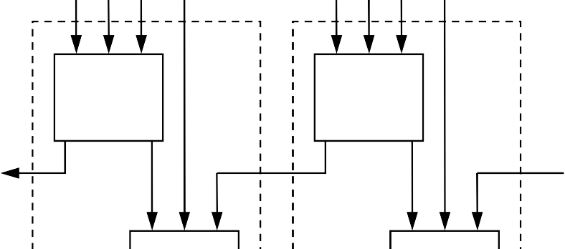
Datapath – Wallace Tree Multiplier
Inputs
Inputs
FA
FA
C
c
s
c
s
out
^{C}in
^{C}in
FA
FA
FA
^{C}out
FA
FA
c
s
c
s
Outputs
Outputs
4-2 compressor
Carry-save adder

Slide 39
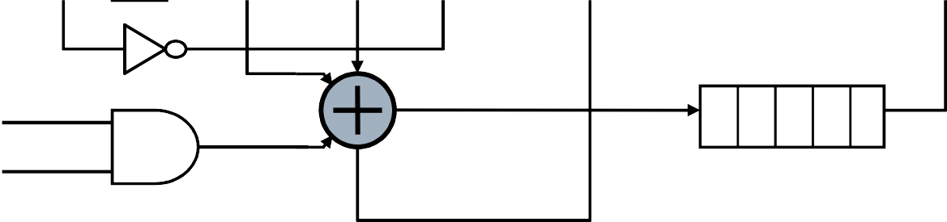
Datapath – Serial Multiplication
Serial multiplier
reset
serial register
X Y
1. Require MN clock cycles to produce a product for an N-bit multiplier and a M-bit multiplicand

Slide 40
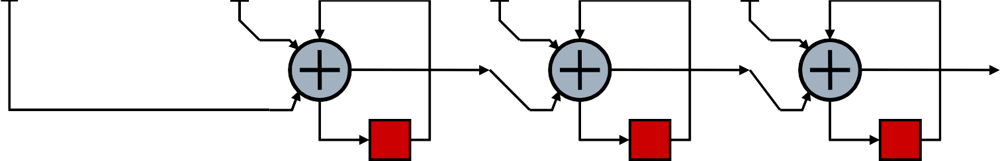
Datapath – Serial Multiplication
Serial/parallel multiplier
Y₀ Y₁
Y₂
Y₃
X
D
D
D
S₀
S₁
S₂
D
D
D
Require M+N clock cycles to produce a product for an N-bit multiplier and a M-bit multiplicand
The critical path consists of the adders

Slide 41

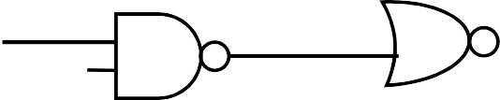

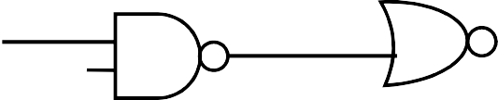
Control – FSM
Moore
input
clk
Mealy
output
input
clk
output

Slide 42
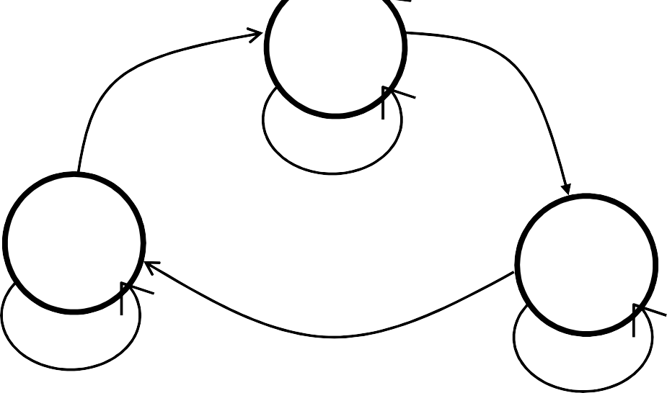
Control – FSM
FSM design procedure
  Draw the state-transition diagram
  Check the state diagram
  Write state equations (Write HDL)
An example of state-transition diagram
R
-A
IDLE
IDLE: (S1,S0)=(00)
WAIT: (S1,S0)=(01)
EXIT: (S1,S0)=(10)
A: car-in
C: change-ok R: rst
A
-A
EXIT
WAIT
C
-C
A

Slide 43
Control – FSM
 Check the state-transition diagram
 Ensure all states are represented, including the IDLE state
 Check that the OR of all transitions leaving a state is TRUE. This is a simple method of determining that there is a way out of a state once entered.
 Verify that the pairwise XOR of all exit transitions is TRUE. This ensures that there are not conflicting conditions that would lead to more than one exit- transition becoming active at any time.
 Insert loops into any state if it is not guaranteed to otherwise change on each cycle.
 Formal FSM verification method
 Perform conformance checking

Slide 44
Control – Verilog Coding Style for FSMs
module
toll_booth(clk,rst,car_in,change_ok,green);
input
clk,rst,car_in,change_ok; green;
state_reg, next_state;
EXIT: if (car_in==1’1) begin next_state=EXIT; green=1’b1;
end else begin
next_state=IDEL; green=1’b0;
end default: begin
next_state=IDLE; green=1’b0;
end
output reg[1:0]
parameter IDLE = 2’b00; parameter WAIT = 2’b01; parameter EXIT = 2’b11;
always @(posedge clk or posedge rst) begin If (rst==1’b1) state_reg<=IDLE;
else state_reg<=next_state;
end
always @(state_reg or car_in or change_ok) begin
endcase
case(state_reg):
IDLE: if (car_in==1’1) begin next_state=WAIT; green=1’b0;
end else begin
next_state=IDEL; end
WAIT: if (change==1’b1) begin next_state=EXIT; green=1’b1;
end else begin
next_state=WAIT; green=1’b0;
end
end
endmodule

Slide 45
Control – PLA
Structure of a PLA
Minterms
AND array
OR array
a b c d
f₀ f₁ f₂ f₃
A PLA represents an expression of sum-of-product (SOP)
f_{i} = ∑ m_{i} (a, b, c, d )
i
f₁ = a ⋅b ⋅ c ⋅ d + a ⋅b ⋅ c ⋅ d + a ⋅b ⋅ c ⋅ d

Slide 46
Control – PLA
Fuse-programmable PLA
Fuse
a
b
c
d
f₀
Jin-Fu Li, EE, NCU
f₁
f₂
f₃

Slide 47
Control – PLA
Logic gate diagram of a PLA
a
b
c
d
f₀
Jin-Fu Li, EE, NCU
f₁
f₂
f₃

